Slide 1


An Introduction to R
Dr Chris Boulton & Dr Josh Buxton
31st January 2024

Slide 2
Why to learn R?
Why not to learn R?
One of the main programming languages used for data science.
Popular in both academia and business.
Easiest to learn data science skills within R, data wrangling, data visualisation and machine learning.
Other, popular languages (e.g. Python) are more general, not just for data science.
IT’S FREE!
You might want a more general program such as Python (good for text analysis).
Harder to run full models (such as on something like Fortran).
Social sciences may benefit from a program like SPSS (although R does the same, just more generally).

Slide 3
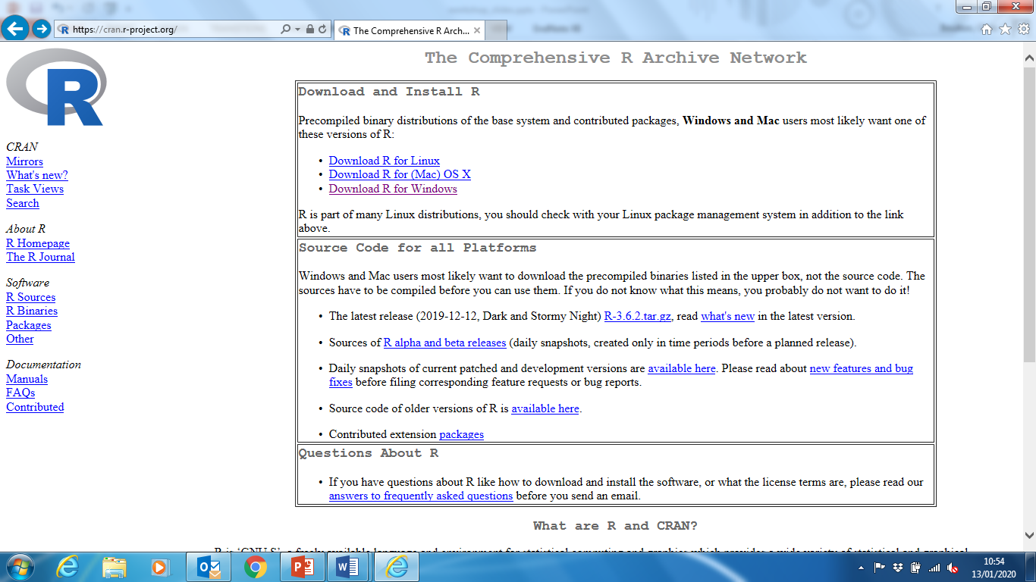
Installing R
R can be downloaded from the CRAN project website – cran.r-project.org (or you can google it).
Click ‘Download R for…’ for whichever platform you’re using and follow the instructions (each platform is different).
There is another programme called RStudio which uses the R programming language with more ‘thrills’ but we focus on R here for simplicity.

Slide 4
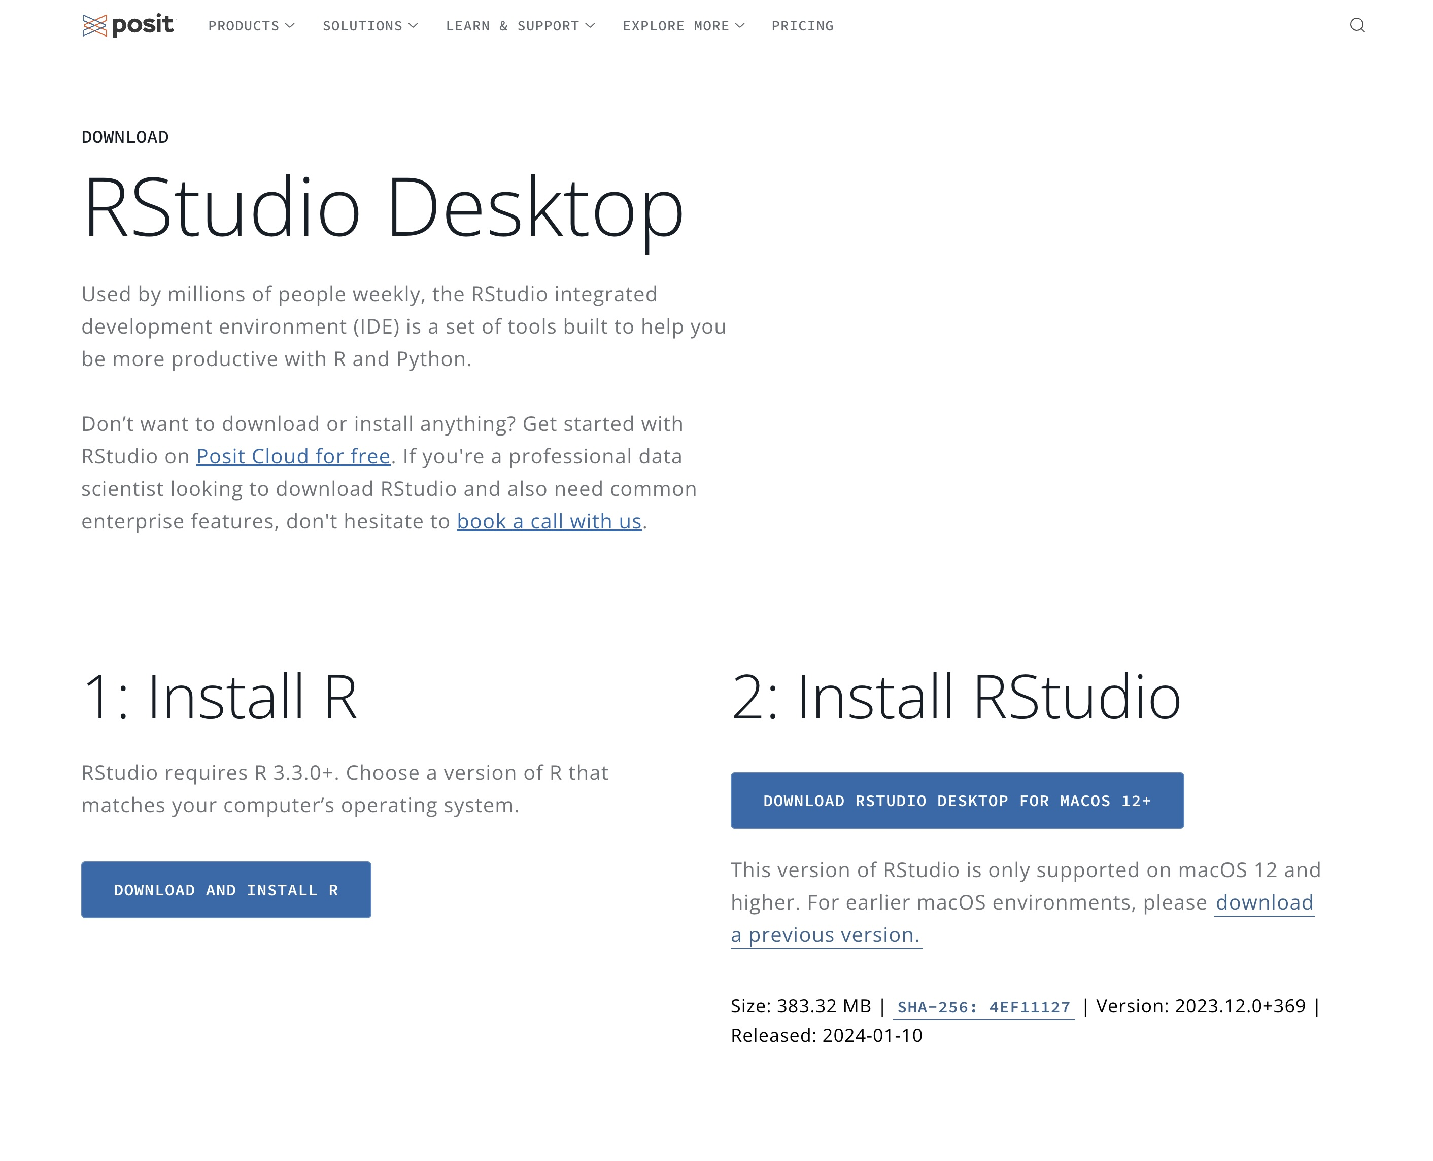
Installing RStudio
However, if you did want to use Rstudio is can be downloaded here: https://posit.co/download/rstudio-desktop/
You will have to still download R (which can be done here too as well as on CRAN like previous slide).
Note that scrolling down on this page allows you to download RStudio for different OS (Windows, Mac, Linux etc).

Slide 5
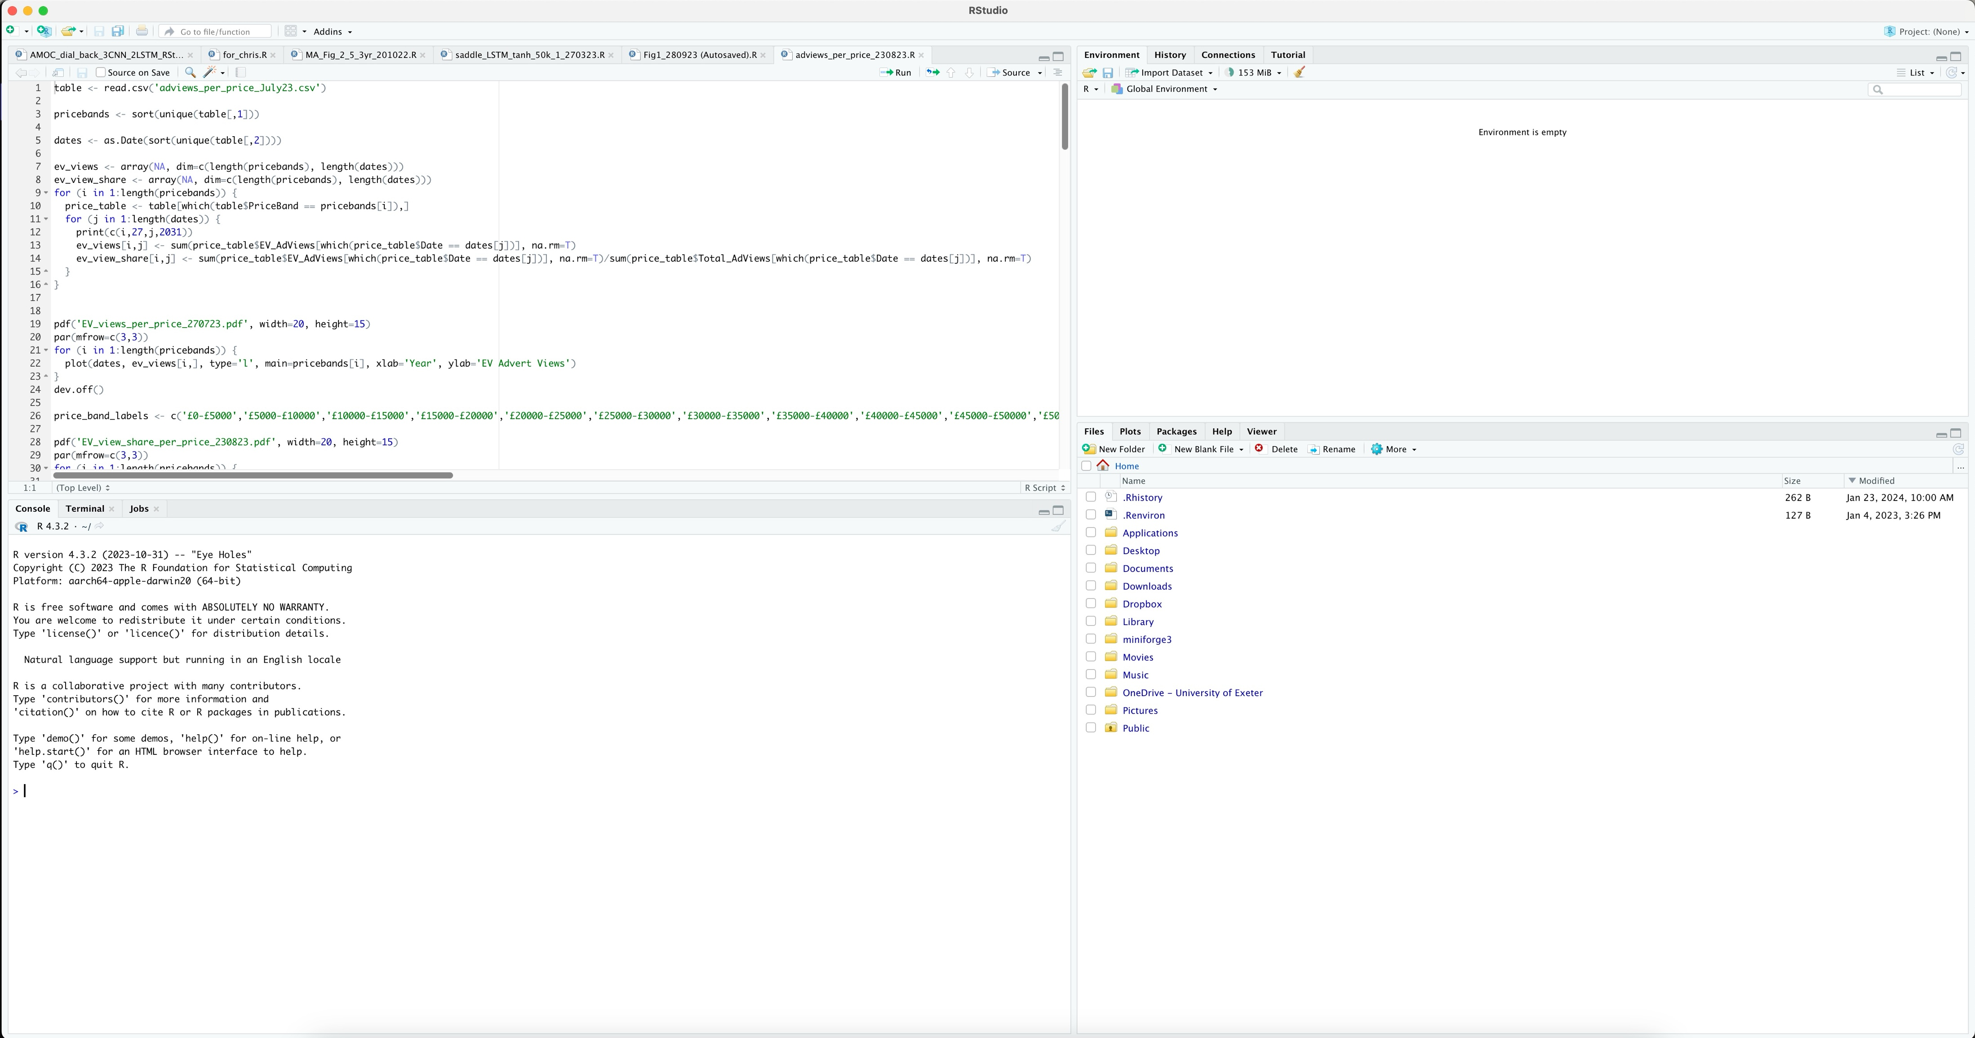
RStudio Workspace
The slides here show ‘basic R’ for simplicity but RStudio is split into 4 sections shown here.
From now on we will be generally focusing on the ‘Code’ and ‘Terminal’ windows in basic R.
You are very welcome to use whichever R you would like and we can help with either!
Code
Environment
Terminal
File Space/Plots

Slide 6
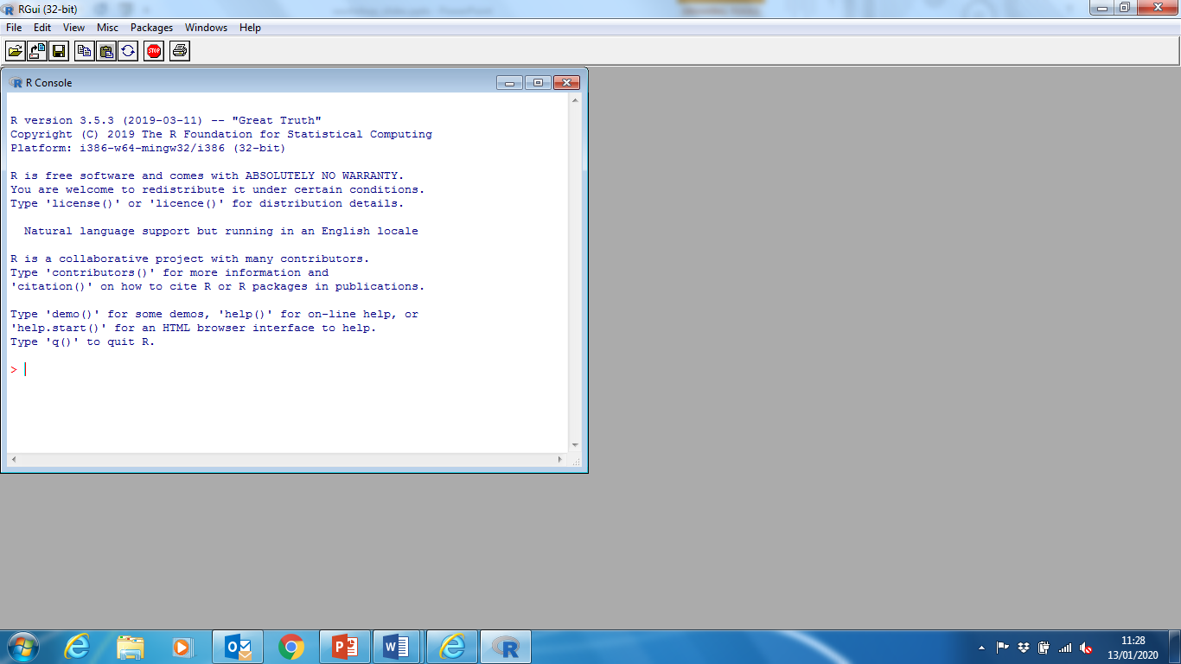
Opening and Using R
On opening R, you should be presented with something that looks like this.
R looks for scripts and files in the current directory. It is good to get into the habit of changing this on start-up.
This can be done by going to File -> Change dir… and then navigating to a folder than has your files in (or a new one in this case!)
Alternatively you can use the function ‘setwd()’ (more about functions later).

Slide 7
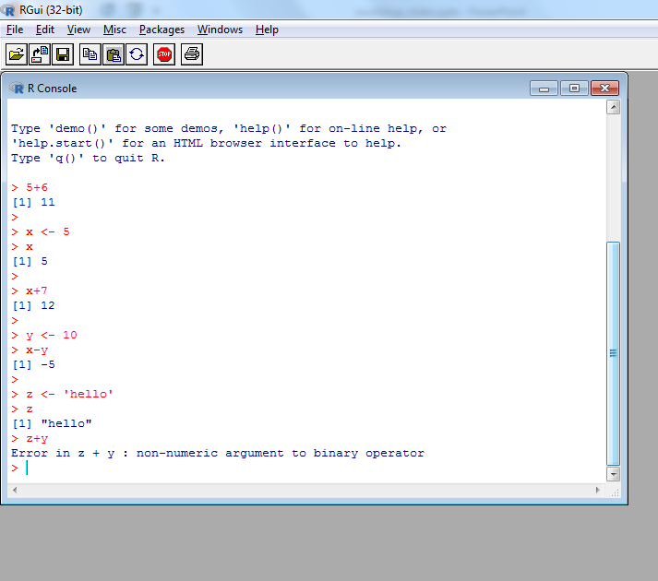
Opening and Using R
Very simply, you can treat R like a big calculator. Typing out sums and pressing enter will return the answer.
You can assign values to objects, such as setting the value of x equal to 5 using the assign (<-) operator. (You can point this is either direction if you want to).
Then you can use these objects in sums, either with number or other objects for example.
You can also make character strings, adding a string and number together will produce an error!

Slide 8
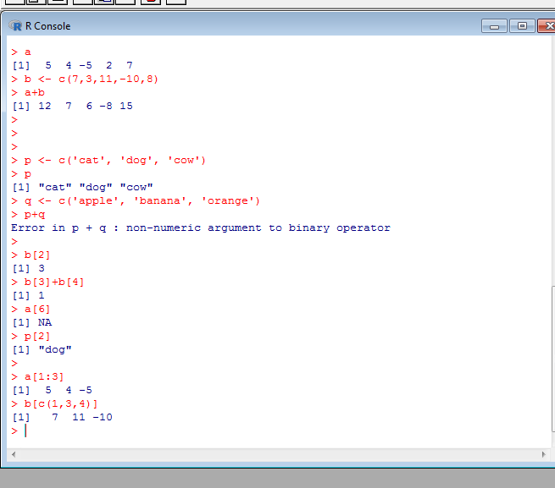
Vectors and Indexing
You can use the combine function ‘c()’ to make a vector of numbers, character strings, logic statements etc.
These too can be added together, when it makes sense to (again, you can’t add strings).
Certain values can be picked out using indexing brackets ‘[]’. The value in the bracket denotes the position of the value we want – a[2] gives the second value of a.
Again we can use vectors within the brackets to pull out multiple values.
A colon notation makes a vector that starts at the first number and increases in steps of 1 to the second number – 1:3 equals 1 2 3

Slide 9
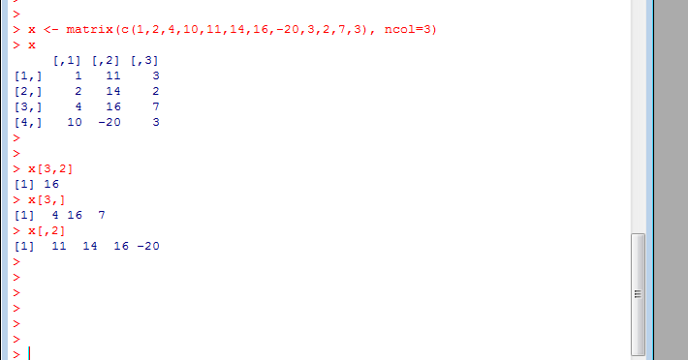
Vectors and Indexing
The same can be done for 2-dimensional arrays (and any number dimensional arrays but we stick for 2 for now).
2D arrays can be made using the matrix() function, where a vector is supplied and the number of columns (don’t worry we will cover functions properly later).
Indexing can be used to pick out a value from a row and a column x[row,column], or a number of rows and columns.
To show a whole row or column for a give column or row respectively, leave it blank.
For example x[2,] will pick out the second row and x[,3] will pick out the third column.

Slide 10
Built-in functions
There are a number of built-in functions in R to do some simple analysis on datasets. They can be used on any numerical object and even some non-numerical ones (such as strings) in certain cases.
The simplest of functions act by applying something to the object inside the brackets, whereas some have additional arguments you can add in (such as the matrix() function seen on the slide before).
In most of these cases, these arguments will have default options that you can use by not referring to them.
All functions have a help file, access by typing a question mark before the name of the function (e.g. ?mean). This gives you the details on the function and details about default parameter values and also some examples of how to use it

Slide 11
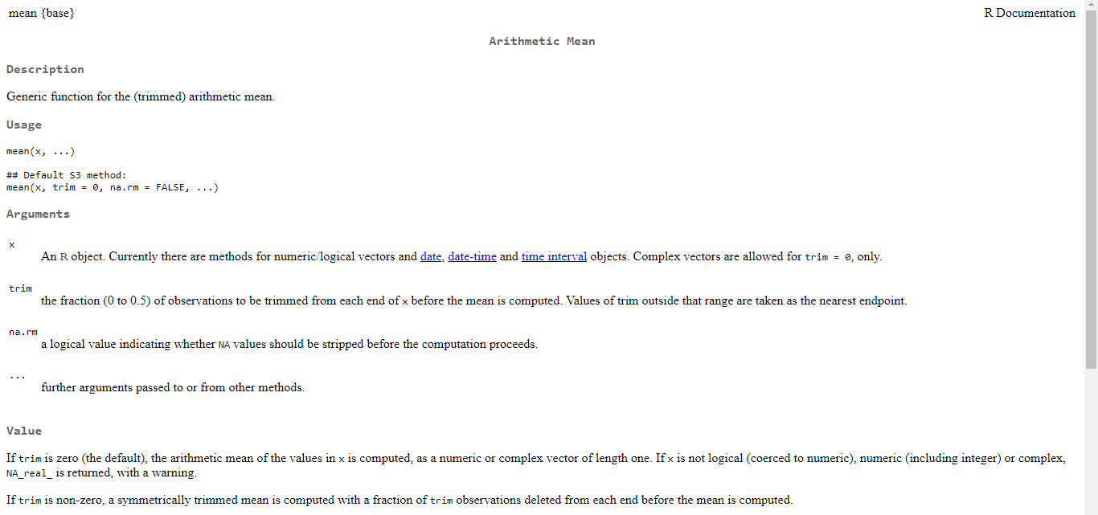
Built-in functions

Slide 12
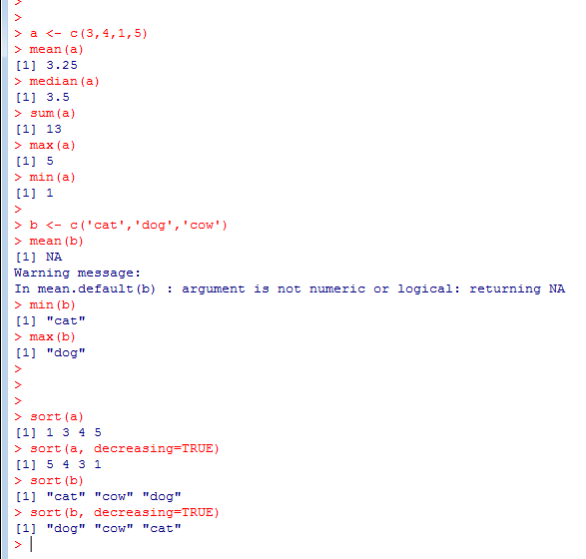
Built-in functions
Some examples of built-in functions are shown here.
Note that some of these functions work for character strings too.
The sort() function here can sort items both ways, with an added argument to change the default from FALSE to TRUE. Check the help file of the sort() function for more information.

Slide 13
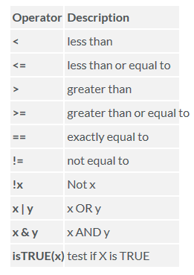
Logic Statements
We can use logic statements to test if things are TRUE or FALSE.
Logic statements that can be used in R are shown here (with examples on the next slide).
The response will either be a TRUE or a FALSE, known as logical constants.
In our statement we can include more than one query using and (&) and or (|) in the expression.
We can use logic statements to check things about our data, such as looking for a specific entry in a table.

Slide 14
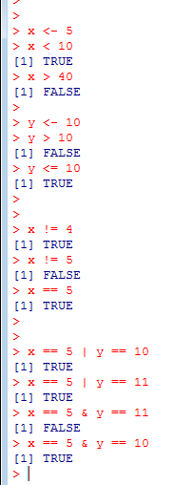
Logic Statements
If x equals 5, then it is TRUE that x is less than 10. It is FALSE that it is greater than 40.
If y equals 10, then it is FALSE that it is greater than 10. It’s true that it is less than or equal to 10.
It is TRUE that x does not equal 4, and FALSE that it does not equal 5. It is TRUE that it does equal 5.
Checking the two together, it’s TRUE that either x equals 5, or y equals 10 (because x equals 5), and TRUE that x equals 5 or y equals 11. However it’s FALSE that x equals 5 and y equals 11, because it’s TRUE that x equals 5 and y equals 10.
While these things seem difficult when they’re all listed like this, if you think about the question you want to ask yourself and fit it into the form of a logic statement then you should be ok!

Slide 15
Scripts, saving and loading
Rather than just using R by typing commands into the command window, you can type all the commands in a script to run all together using the source() function (or line by line if you wish by pressing Ctrl + R when on the line you want to read in).
Using scripts is the more common way to use R. You can make a new script by going to File -> New Script.
After typing some commands into the new window that appears, you can save your script (a .R file) as you would a file in any other program (File -> Save as). It will be saved into your current directory.
It is always good practice to comment on your scripts. Anything on a line of code after a # symbol is ignored by R, allowing you to give yourself notes about what you have done (see next slide in the example).
You can save the value of objects in R (such as x, y, and others from before) using the function save.image(), where you put the file name you want to save it under in the brackets as a character string. These usually have the .RData extension.
Other files can be loaded in (or you can load something at the start of your script for example), using the load() function, again with the name of the file in the brackets.

Slide 16
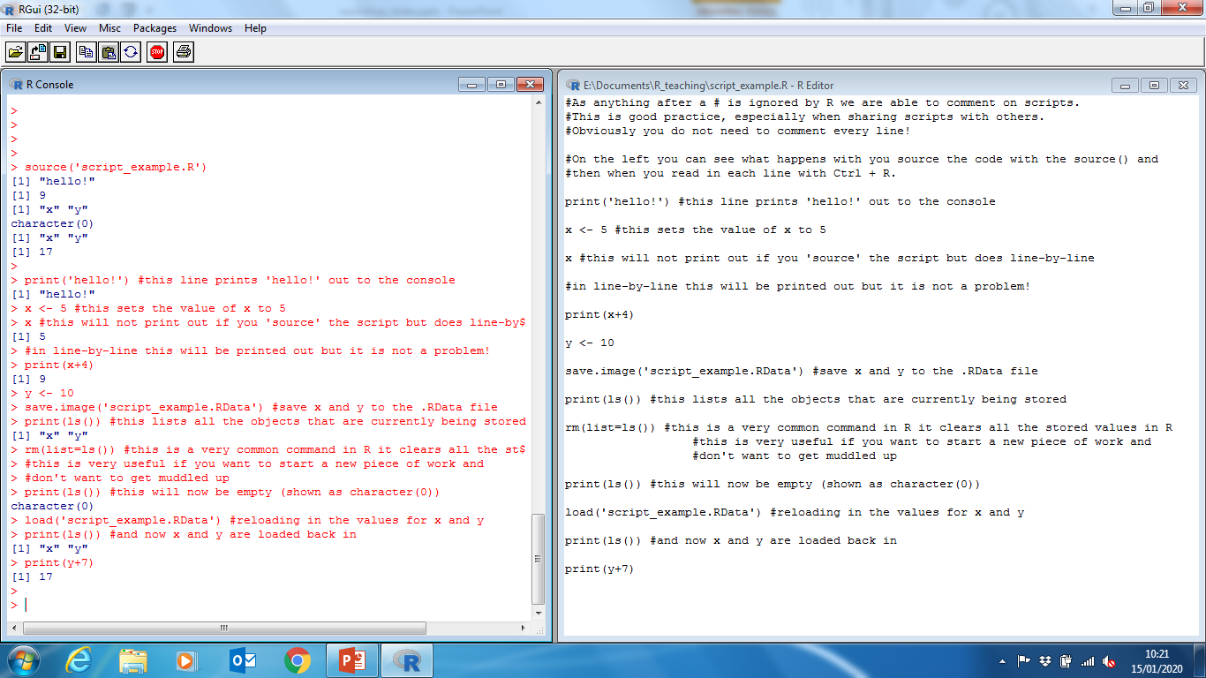
Scripts, saving and loading

Slide 17
if-statements, for loops and the which() function
Now we are writing scripts to store lines of commands, we can begin to analyse things in more detail. Some of the building block for this are if-statements and for loops. We also look at the which() function.
if-statement
for loop
which()
Checks in a logic expression inside the () brackets is TRUE.
If it is, then does commands in {} brackets.
If FALSE, will skip these.
Uses a logic statement in the brackets and gives the position(s) in an array where expression is TRUE.
Can also use which.min() and which.max() to find position of min and max.
For each value (a) in an array, for example (b), do some commands.
Does not have to use a or b in the commands.
if (logic statement is TRUE) {
various commands
}
for (a in b) {
various commands
}
which(logic statement)

Slide 18
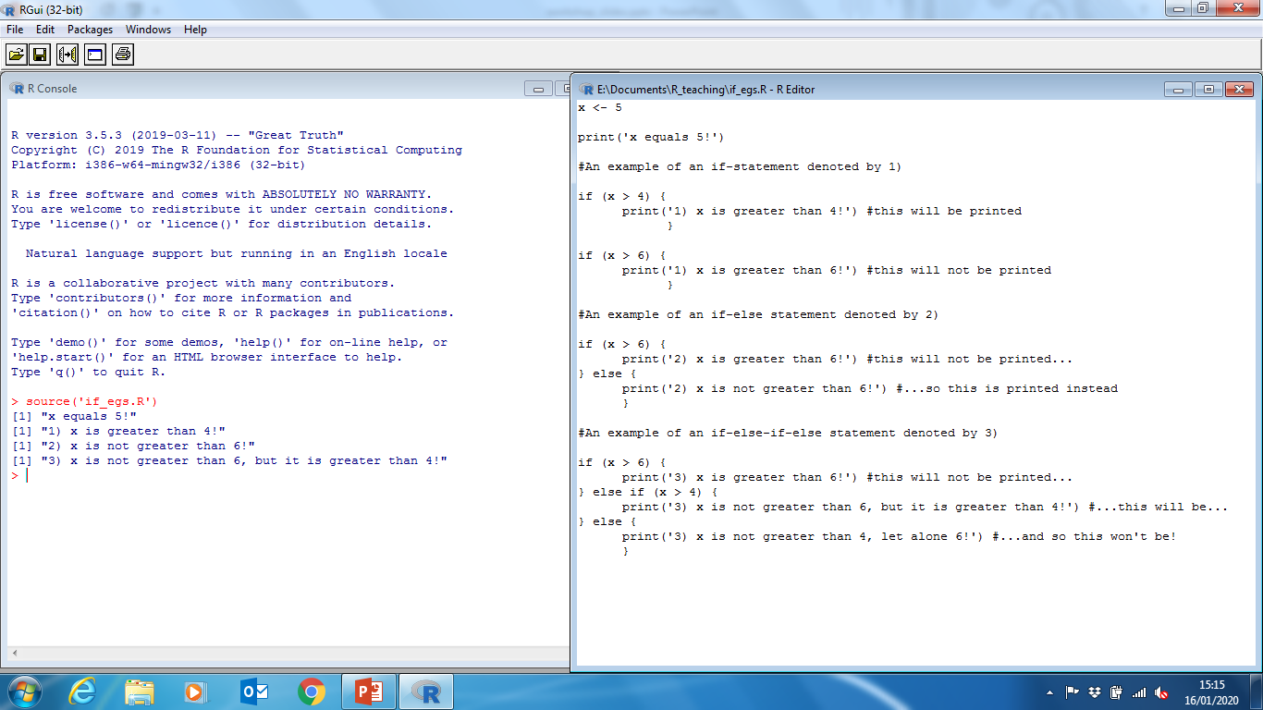
if-statements, for loops and the which() function

Slide 19
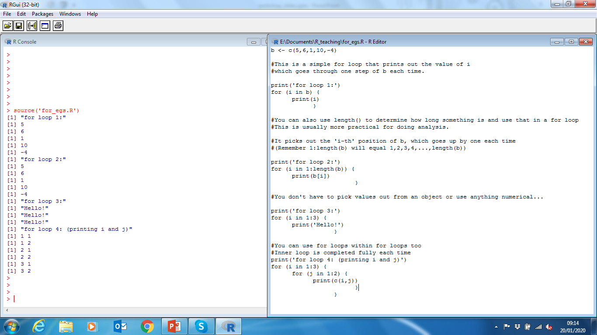
if-statements, for loops and the which() function

Slide 20
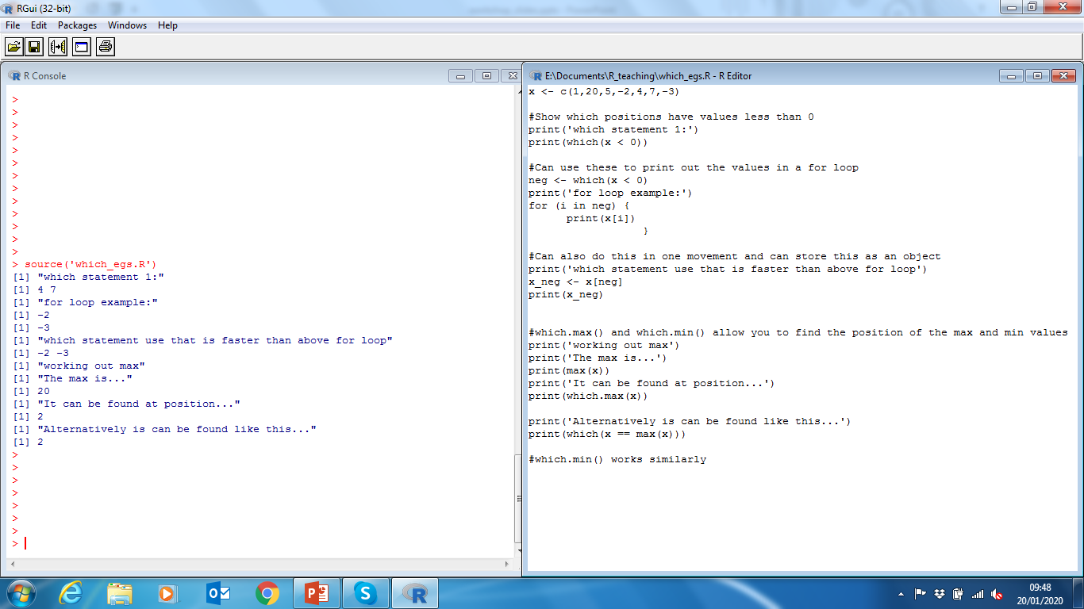
if-statements, for loops and the which() function

Slide 21
Make your own functions!
The arguments for the function, can be given default values
Name of function
Everything learnt so far can be combined into self made functions.
Functions, as previously stated have an input, some arguments, and an output.
They are created as shown on the right.
They are written into a script and then can be used once that script has been sourced.
function_name <- function(arg1, arg2=default2, arg3) {
some commands
return(output)
}
Commands using the inputs
The return() function is used so that when you assign the output of the function to an object (or print it out), this is what is stored (or printed).

Slide 22
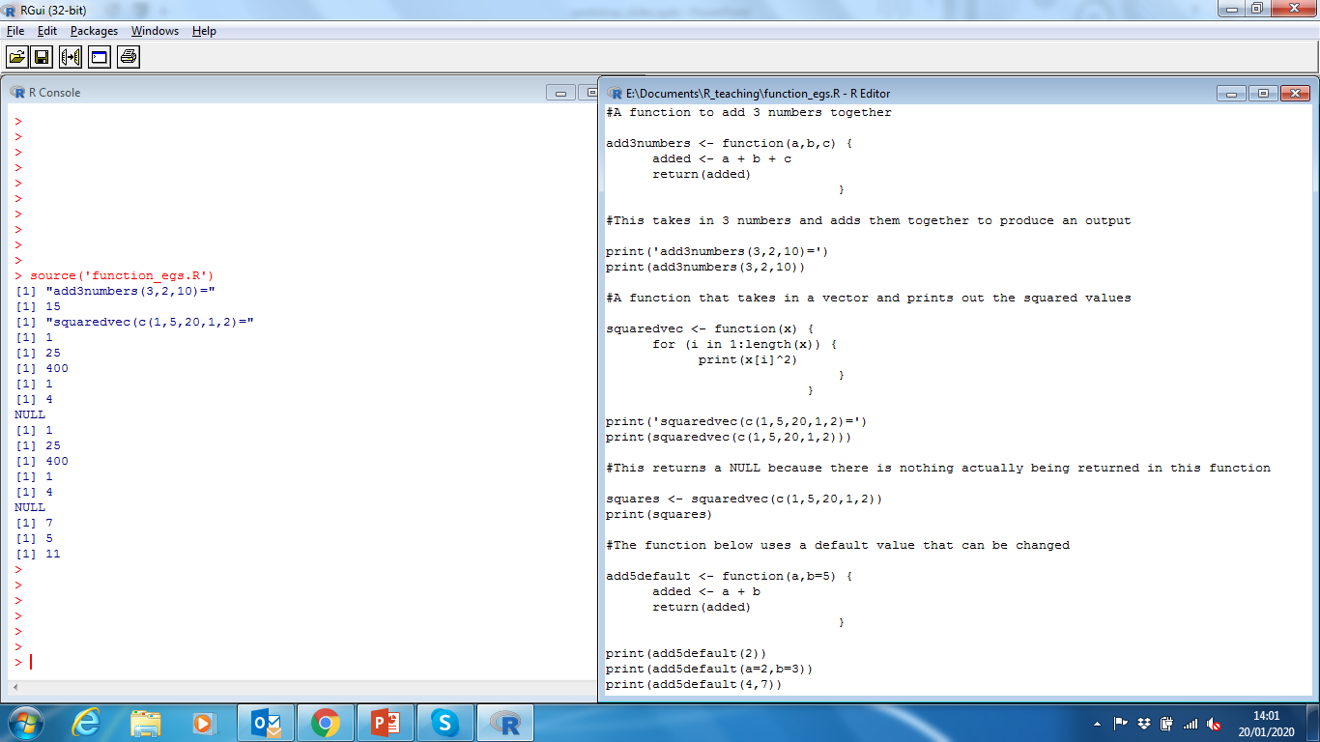
Make your own functions!

Slide 23
Reading in data
Data can be read into R from a number of different sources.
We restrict use here to csv files, although other files are read in similarly.
Files are read in using the read.csv() file, with default arguments that there is a header row with column names in it (header=TRUE) and the separation character being a comma (sep=‘,’).
With headers, the name of the columns can be used to select the values in the column using the $-sign. Example is shown on the right.
To see all the column names, use the function names().
The file has to be in the current directory, or the file path has to be supplied.
Table <- read.csv(‘data.csv’)
print(Table$col1)
print(Table[,1])
names(Table)
Table$newcol <- 5
Table$newcol[2] <- 6
These two do the same thing, assuming column one in the table is called ‘col1’.
Can make new column in table by adding them like so. In this case all values would be 5, and then the second row would change to 6.

Slide 24
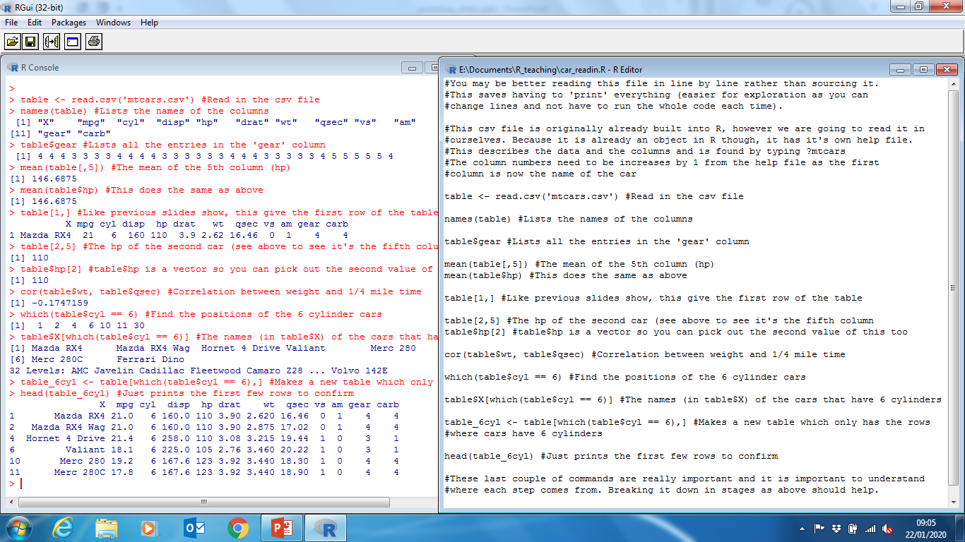
Reading in data

Slide 25
Making plots
Simple plots can be made with the plot() function.
You can plot either one variable (which will plot against the values 1,2,3,… on the x axis), or two values plotted against each other.
The order of the variables is important; when there are two, the first one is plotted on the x axis. On its own, a variables will be plotted on the y axis.
The arguments in this function allow you to customise plots (see the plot() help file for all info).
The most important ones are shown on the right.
type - Default ‘p’ for points, can also be ‘l’ for line, or ‘b’ for both.
pch - The symbol plotted for points, you can google the numbers needed to get certain symbols, or plot letters or numbers by using them as a character string (e.g. pch=‘A’).
lty - The type of line plotted, default (1) is solid, dotted line would be lty=3 for example. Google the other numbers.
col - The colour of the line or points plotted.
main - The title of the plot, provided as a character string.
xlab/ylab - The labels of the x and y axis, again provided as a character string.

Slide 26
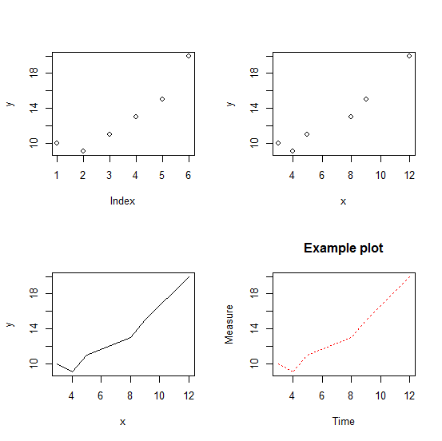
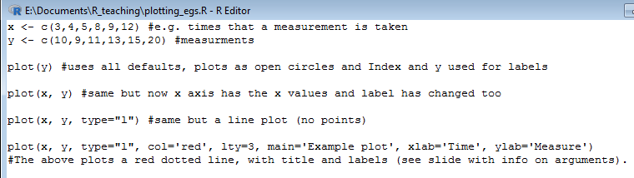
Making plots
Once you have made a plot, you can save as you would a script, by going to File -> Save as… when the plot is the active window.
You can click and drag the size/shape of the window before saving.
(To make a panelled figure, use the command ‘par(mfrow=c(2,2))’ to make a 2 row by 2 col set of plots filled by row first)

Slide 27
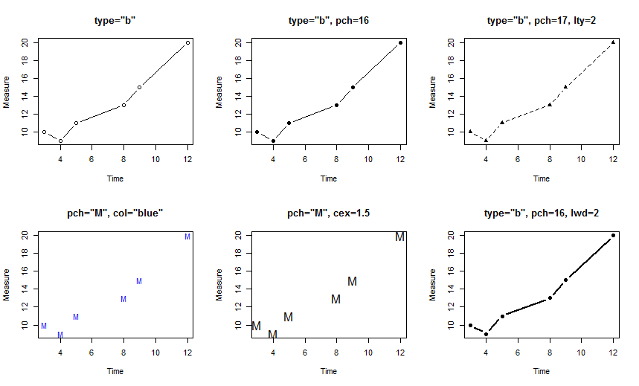
Making plots

Slide 28
Various analysis/plotting
We have learned how to carry out simple analysis etc in previous slides.
We now look at some more analysis and plotting we can do.
There is a focus here on the programming side rather than the mathematics side.
It’s impossible to show all the analysis that R can do here, but simple tests should work similarly and with help files it should not be a problem to run other analyses.
We focus on the cars csv file from previous slides for this part (mixed in with some table manipulation also seen).

Slide 29
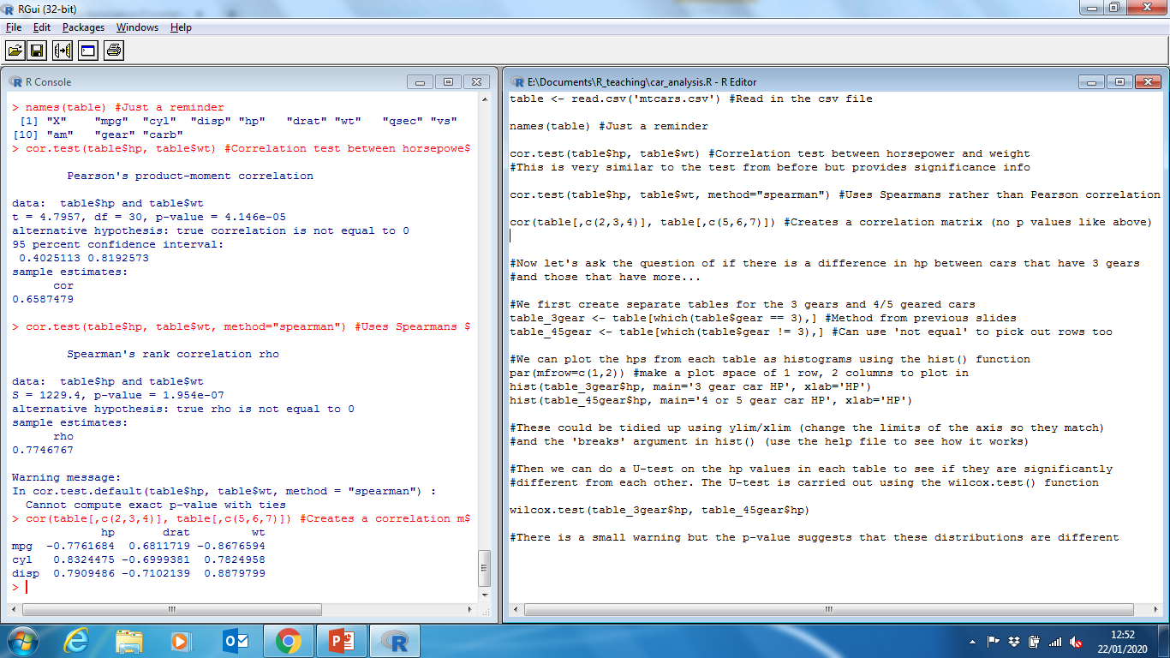
Various analysis/plotting

Slide 30
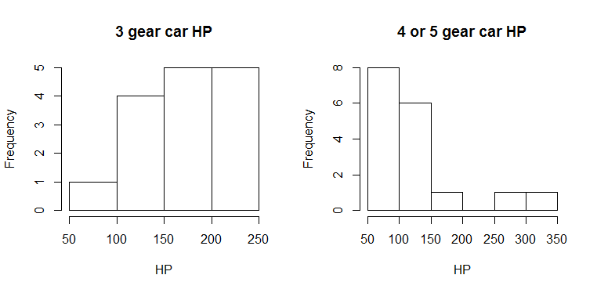
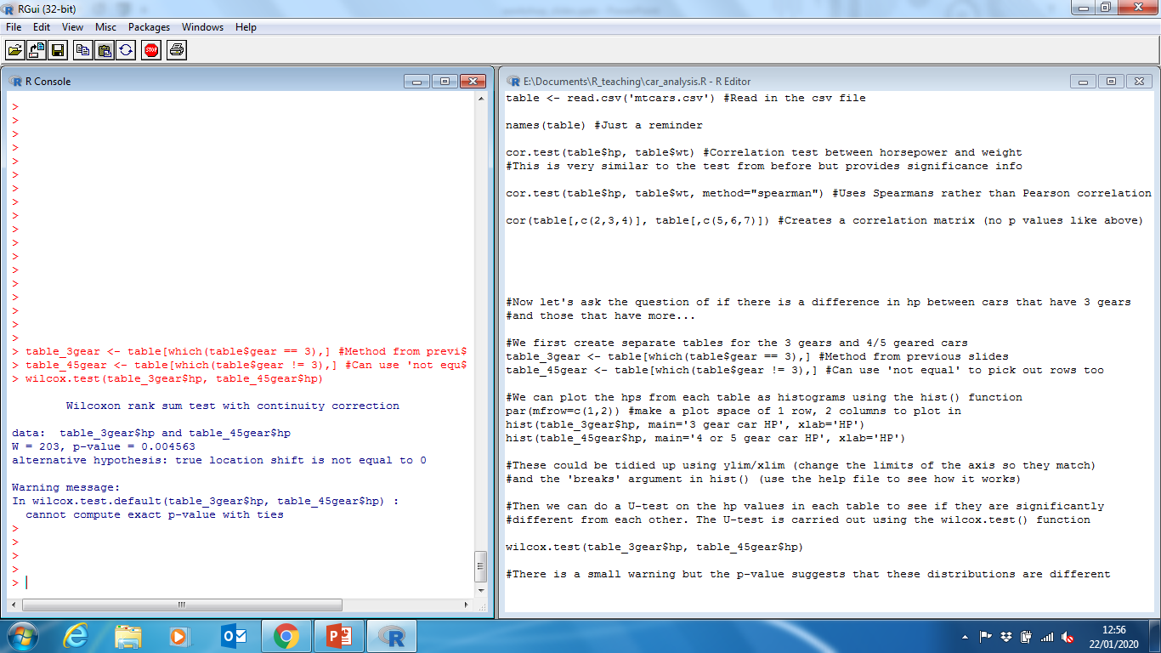
Various analysis/plotting

Slide 31
Linear Regression
A vector of the dependent measurements
Assigning output to an object
We now look at linear regression, used to model the relationship between some explanatory variables and dependent variable.
We will again look at the cars dataset, treating the miles per gallon (mpg) variable as the dependent one we are trying to explain.
We assign the output of the lm() function to an object, which we can use the summary function on. This tells us how well the model fits and how important each variable is in explaining the dependent variable.
mymodel <- lm(dependentvariable ~ explanatory1 + explanatory2)
summary(mymodel)
Gives a summary of the model, information about the variables, overall fit etc.
Vectors of explanatory variables (can have any number)
Linear regression models are of the form: y = a*x1 + b*x2 + c*x3 + … + intercept

Slide 32
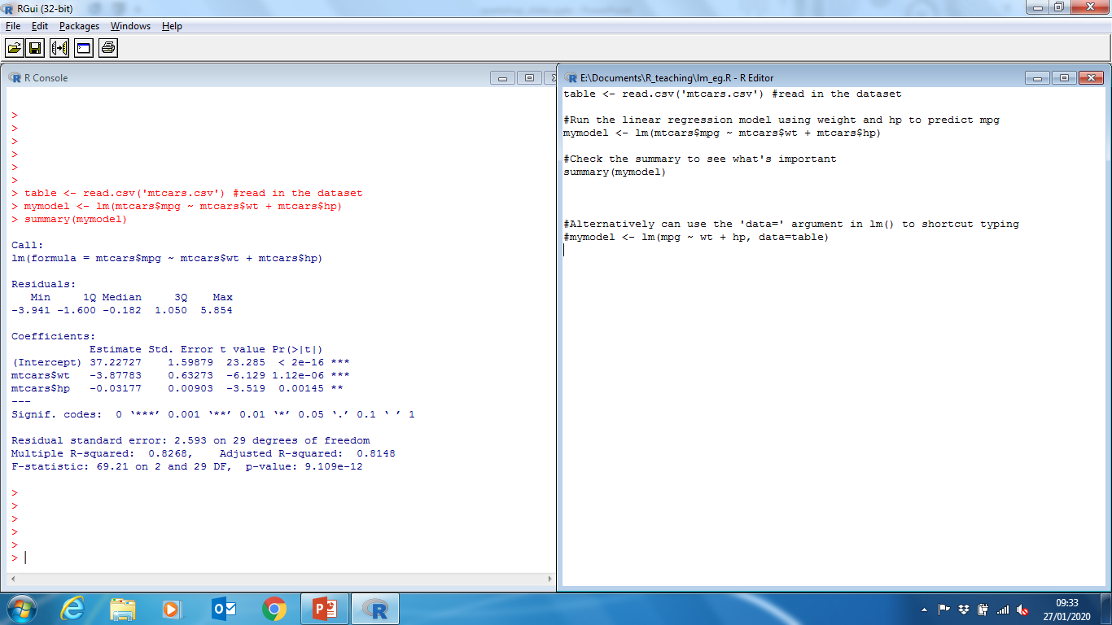
Linear Regression

Slide 33
Linear Regression
These are the coefficients in the model used to estimate mpg. The model in this case is:
mpg = -0.03*hp -3.88*wt + 37.23 (using estimates in table)
This means there is a negative relationship between hp and mpg, and wt and mpg.
(b) The significance of each variable; how different from zero the estimate in (a) is. Zero would suggest the variable is not significant and so not needed in the model/equation above. The ‘Signif. codes’ are a key for the stars; p<0.01 (p=0.00145) for hp so is very significant, and wt has p<0.001 so is even more significant.
(c) R-squared values tells you have much of the variance is explained by the model when compared to a model where all the coefficients is zero and using the mean value as the intercept. 82.6% is very good.
(d) The F-statistic tells you the ratio between the variance explained and unexplained by the model, and the p-value gives the significance of this. Can be thought of as a measure of the model fit as a whole (very good in this case!)
(a)
(b)
(c)
(d)

Slide 34
Worksheets
There are some worksheets to complete. The first one is designed to look at using R, writing simple functions and some basic analysis. The second and third are in the form of ‘notebooks’ and look at the sort the analysis you might do with real world data.
These notebook worksheets are harder (but doable!) – There are word doc versions if you want to use them in R/Rstudio too.
These slides are designed to be looked back upon for help in the worksheets. The example R scripts from these slides are also available.
One of the most common mistakes when trying to source files is that R is looking for them in the wrong directory – DO NOT FORGET TO SET YOUR DIRECTORY BEFOREHAND AND SAVE FILES INTO IT!
Don’t be afraid to ask for help! Honestly, no question is ‘too stupid’ ☺

Slide 35
Notebooks
The second and third worksheets are notebooks called ‘Exe_flow_analysis.ipynb’ and ‘Amazon_analysis.ipynb’ and are found in the ELE folder.
These give you the flexibility to combine text and code and are great for teaching so code can be explained easily. You can also alter the code blocks and see the output in the same file.
Most easily they are used on Google Colaboratory. After uploading these files to your Google Drive, go here: https://colab.research.google.com/ and save a blank notebook file after following the steps. This should give you the ability to open these files from your Drive.
For the third worksheet (the Amazon one) you will also need the .nc file in the ELE folder (it will be explained in the notebook).
There are word document versions of these notebooks if you just want to try them ‘offline’ too.

